Slide 1

DEPARTMENT OF ARTIFICIAL INTELLIGENCE AND DATA SCIENCE ACADEMIC YEAR 2025 - 2026 SEMESTER III ARTIFICIAL INTELLIGENCE LABORATORY MINI PROJECT REVIEW TIC-TAC-TOE USING MINIMAX WITH ALPHA-BETA PRUNING
REGISTER NUMBER | 2117240070277
NAME | Santhosh Kumar S
YEAR | II
SECTION | E
FACULTY IN-CHARGE | BHAVANI M

Slide 2
PROBLEM STATEMENT
The objective of this project is to design and develop an intelligent Tic-Tac-Toe game using the MiniMax algorithm with Alpha-Beta pruning, where the computer plays as an optimal opponent against a human user. The system must evaluate all possible moves, predict the opponent’s responses, and always select the best strategy to either win or force a draw. The project includes a graphical user interface built using Python and Pygame, allowing interactive gameplay, real-time move calculations, and display of performance metrics such as nodes evaluated, pruned nodes, and computation time. The goal is to demonstrate the application of artificial intelligence search algorithms in game decision-making and optimize the execution through pruning techniques.

Slide 3
THEORETICAL BACKGROUND
Artificial Intelligence (AI) enables machines to simulate human intelligence and decision-making. One of the classical problem-solving areas in AI is game playing, where algorithms evaluate possible moves and choose the most advantageous outcome. Tic-Tac-Toe is a fundamental two-player, zero-sum strategy game often used as a benchmark for understanding AI search algorithms due to its limited state space and deterministic nature.
This project uses the MiniMax algorithm, a recursive decision-making technique widely applied in turn-based games. MiniMax operates by exploring all possible future game states and selecting the move that maximizes the AI's chance of winning while minimizing the human player’s chances. It assumes that both players play optimally, making it a perfect-play algorithm. However, MiniMax can be computationally expensive due to its exhaustive search of the game tree.
To optimize MiniMax, Alpha-Beta Pruning is applied. Alpha-Beta Pruning eliminates branches in the decision tree that do not influence the final result, thereby reducing the number of evaluated nodes without affecting accuracy. This significantly improves performance and reduces computation time.
Additionally, a Graphical User Interface (GUI) is implemented using Python's Pygame library, providing interactive gameplay and real-time visualization of AI decisions. The system also displays performance metrics including the number of evaluated nodes, pruned branches, and execution time. This combination of search algorithms and visualization demonstrates how AI techniques can be applied in real-time game environments and highlights the effectiveness of pruning in decision-making systems.

Slide 4
IMPLEMENTATION AND CODE
Link to code in Git-hub Repository
List | Git-hub Repository Links
Implementation of Code Link | https://github.com/JaCk-17-tech/AI-MINI_PROJECT/blob/main/AI%20mini%20project.py
Word Document Report Link | https://github.com/JaCk-17-tech/AI-MINI_PROJECT/blob/main/AI%20REPORT.docx
PPT Link

Slide 5
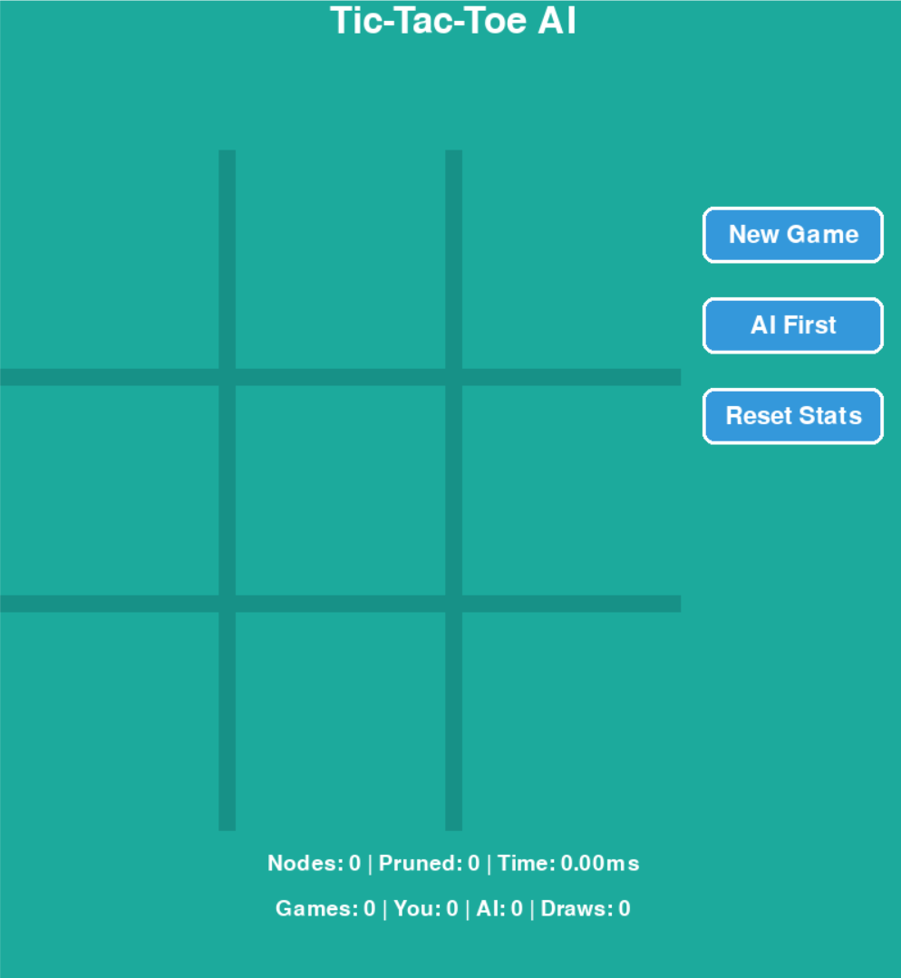
OUTPUT AND RESULTS
Game Interface
This Output shows the main graphical interface of the Tic-Tac-Toe game built using Pygame. The board consists of a 3×3 grid where the human player and the AI take turns placing O and X respectively. The design includes smooth borders, highlighted marks, and clear spacing to ensure good visibility. The interface also displays buttons such as New Game, AI First, and Reset Stats, allowing the user to control and restart gameplay. This serves as the base screen before or during match play.

Slide 6
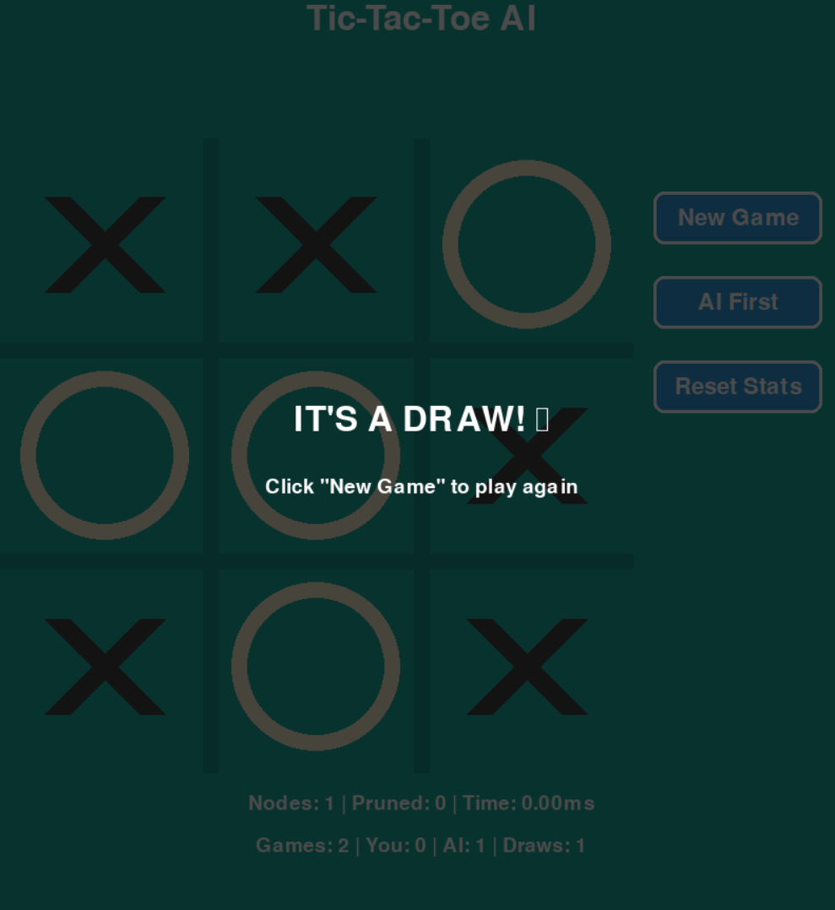
OUTPUT AND RESULTS
Draw Scenario
This screenshot shows a match that ends in a draw. Both the human and the AI have played optimally, resulting in no possible winning move for either side. The MiniMax algorithm ensures that the AI never loses when both players play perfectly, demonstrating correct implementation. A message “IT'S A DRAW! ” appears, indicating the game ended without a winner. This verifies the algorithm’s ability to identify and enforce draw situations.

Slide 7
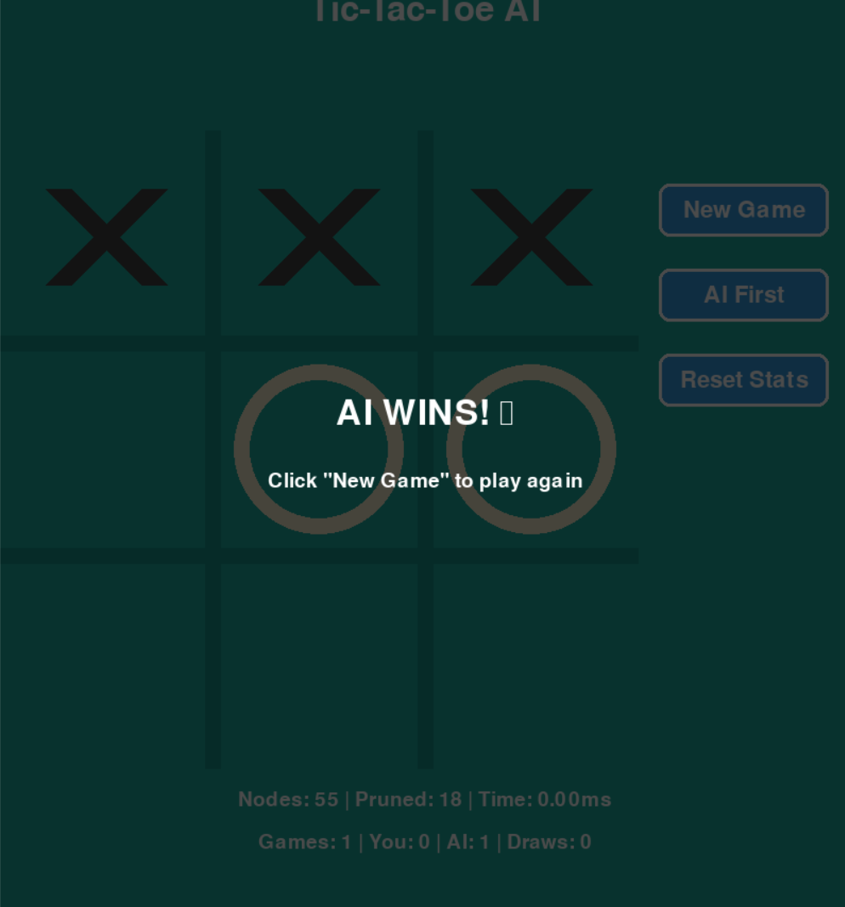
OUTPUT AND RESULTS
AI Winning Scenario
In this Output, the AI (X) wins the match. After analyzing all possible moves using the MiniMax algorithm with Alpha-Beta Pruning, the AI selects optimal moves to either win or ensure the opponent cannot win. Once a winning state is detected, the interface displays a highlighted message: “AI WINS! 🤖”, showing that the algorithm has successfully played strategically and achieved a victory. The board and result overlay confirm a flawless AI decision-making process.

Slide 8
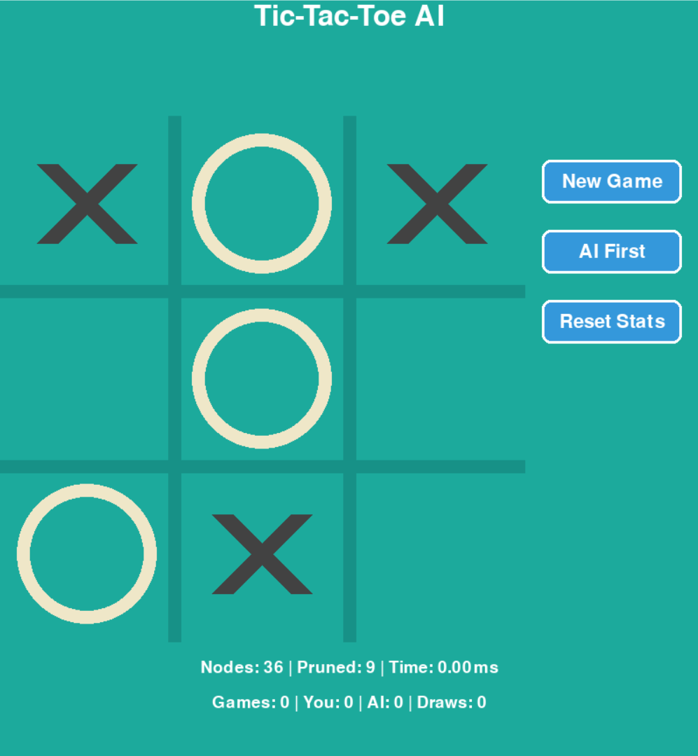
OUTPUT AND RESULTS
Nodes & Pruning Display
This output demonstrates the internal AI performance statistics, such as the number of nodes evaluated, nodes pruned, and computation time for generating the best move. These metrics highlight the efficiency of Alpha-Beta pruning, which eliminates unnecessary branches in the search tree to speed up decision-making. Displaying these values provides transparency in algorithm functioning and proves that the AI is working with optimized search logic.

Slide 9
OUTPUT AND RESULTS
• Successfully implemented intelligent Tic-Tac-Toe AI.
• MiniMax ensures optimal gameplay.
• Alpha-Beta pruning improves computation time.
• Future Enhancements:
- Multiplayer mode
- AI difficulty levels
- Heuristic learning and sound effects

Slide 10
REFERENCES
📖 Books / E-Books
1️⃣ Artificial Intelligence: A Modern Approach Stuart Russell & Peter Norvig Prentice Hall, 3rd Edition (Chapters on adversarial search, MiniMax, alpha-beta pruning)
2️⃣ Python Game Programming by Example A. Shovic & M. Wiemer Packt Publishing (Reference for Pygame usage and game loop structure)
3️⃣ Artificial Intelligence (Sixth Edition) Elaine Rich & Kevin Knight McGraw-Hill (Heuristic search & game-playing concepts)
🌐 Online Standard References
4️⃣ GeeksforGeeks — MiniMax Algorithm in Game Theory https://www.geeksforgeeks.org/minimax-algorithm-in-game-theory-set-1-introduction/ (Concept explanation & algorithm pseudocode)
5️⃣ Pygame Official Documentation https://www.pygame.org/docs/ (Reference for GUI development and event handling)

